Slide 1
AAV-delivered CRISPR-mediated
Cellular Regeneration
Michael Pineda
ASU/NASA Space Grant Scholar
School of Life Sciences Research Fellow

Slide 2
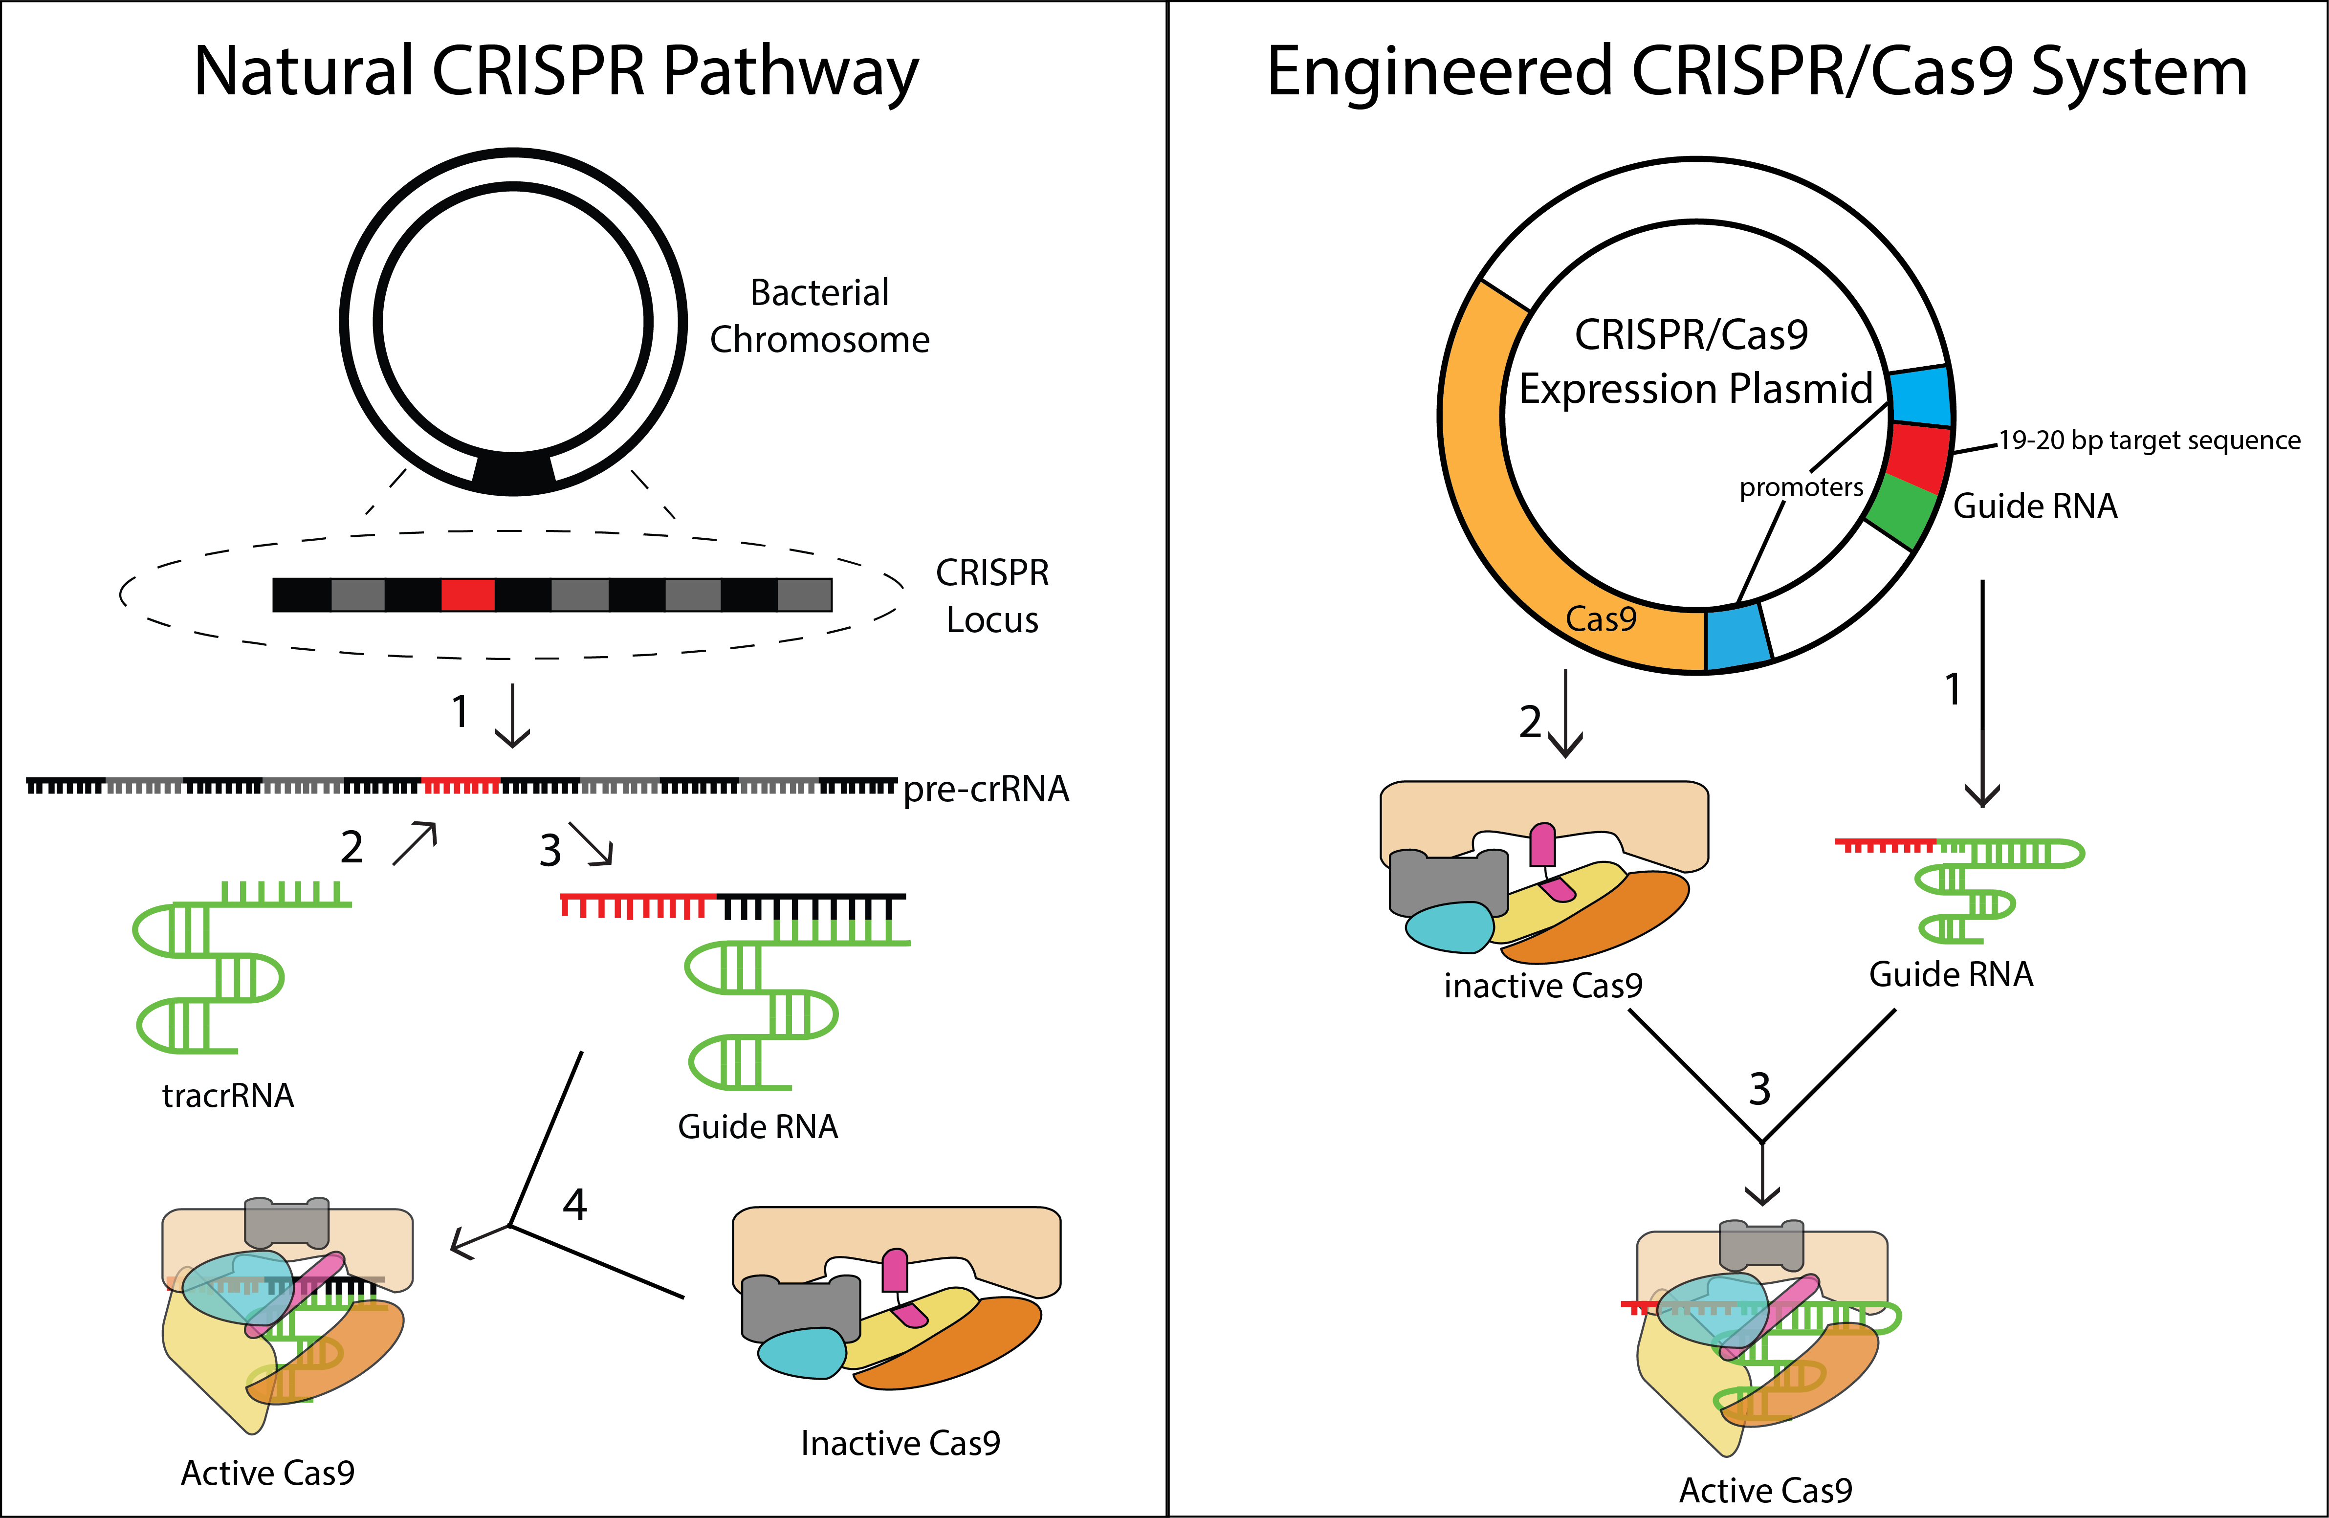
CRISPR-Technology
Peter Cavanagh & Anthony Garrity, Tufts University

Slide 3
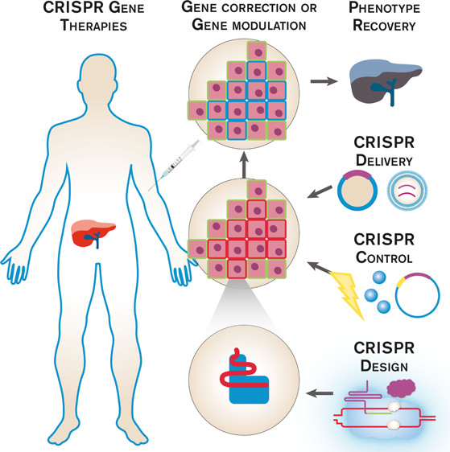
CRISPR Gene Therapies
Pineda et, al. ACS Synth. Biol. 2017

Slide 4
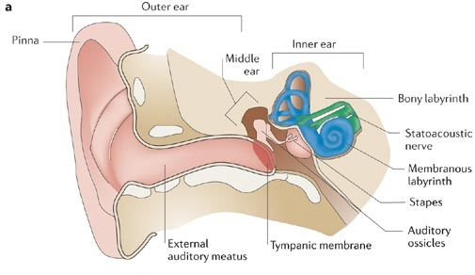
Ear Hair Cells

Slide 5
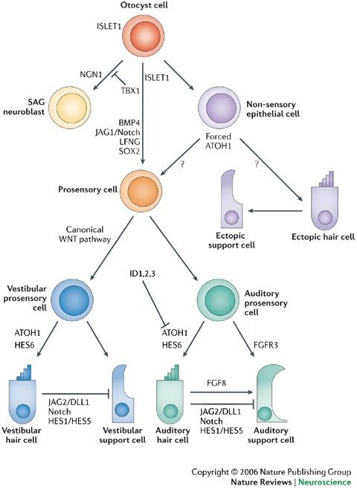
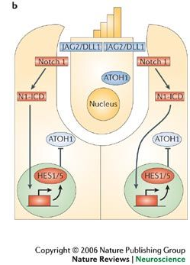
Cellular Regeneration

Slide 6
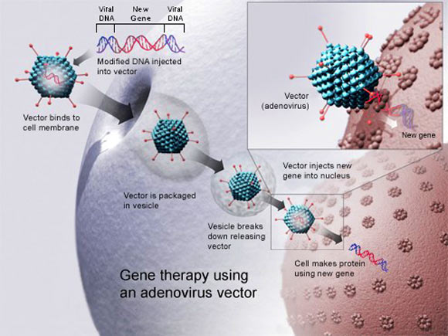
Viral Delivery - AAV
U.S. National Library of Medicine

Slide 7
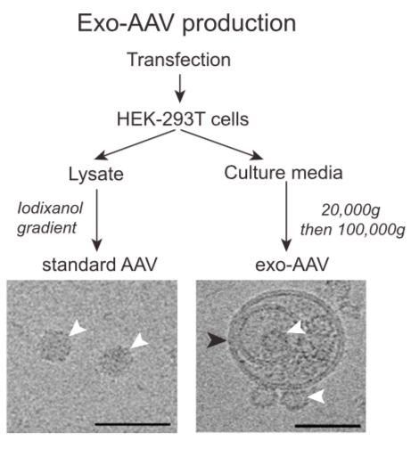
Exo-AAV
György et. al, Molecular Therapy, 2017.
Notes:
Exo-AAV is easier to isolate than AAV and also is less likely to produce anti-aav response

Slide 8
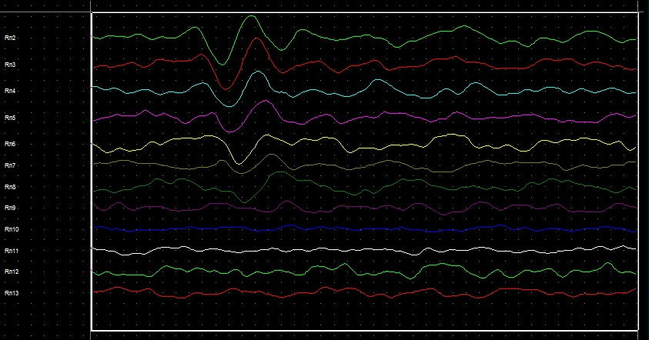
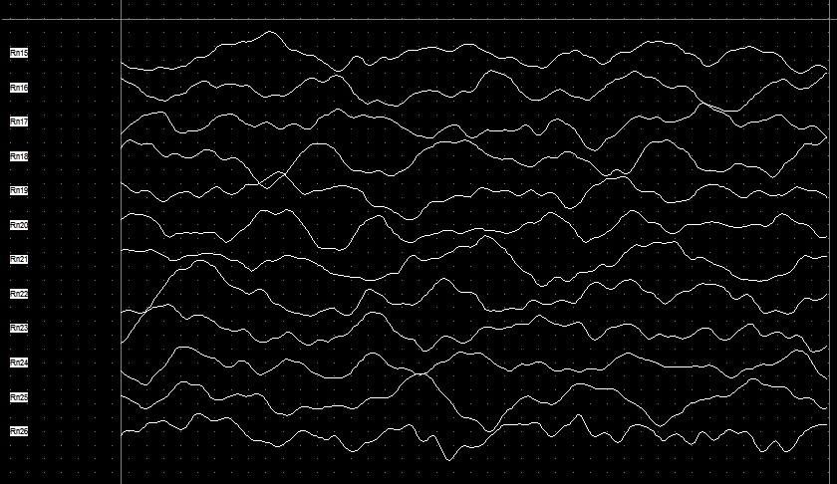
Auditory Brainstem Response
A. Before inducing damage
B. After inducing damage

Slide 9


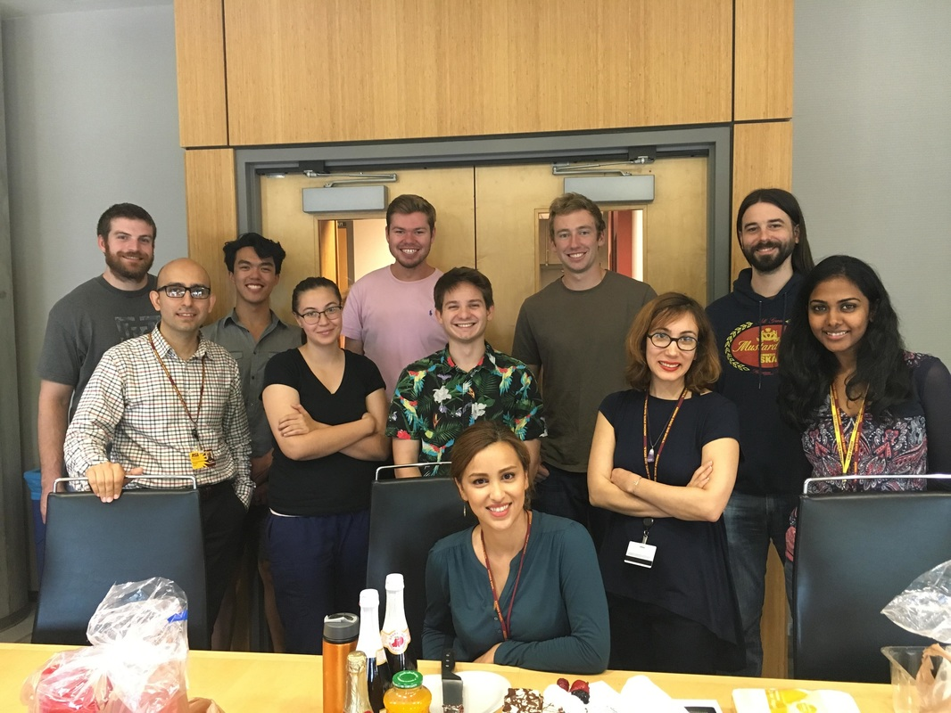


Acknowledgements
SKMO Lab

Slide 10
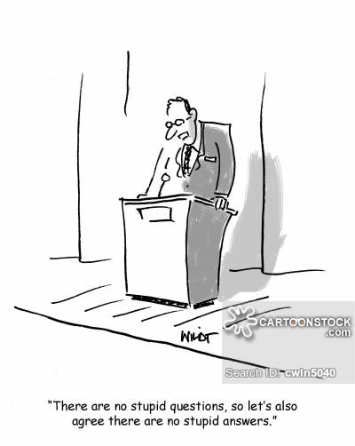
Questions?

